Slide 1
Meiosis
Chapter 6, Section 2

Slide 2
How are genes passed on?
By the 1900’s even though Mendel and other scientists after him had made discoveries regarding the inheritance of traits, genes were still a mystery
Where were they located?
How did they pass on information from one cell to another?
In order to understand this, we have to understand reproduction

Slide 3
Reproduction
What is reproduction?
Remember all living things reproduce
Reproduction is important for all life, because living organisms make organisms like themselves
There are two kinds of reproduction
Asexual reproduction
Sexual reproduction

Slide 4
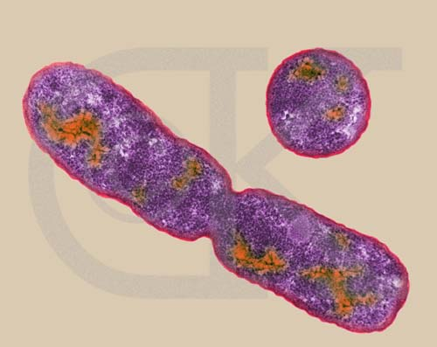
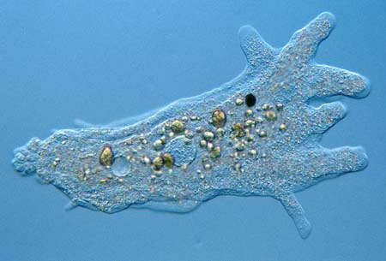
Asexual Reproduction
Only one parent cell is needed for reproduction
Parent cells produce EXACT copies of themselves
Mitosis
Usually the mechanism of reproduction for single-celled organisms

Slide 5
Sexual Reproduction
Two different parent cells, known as sex cells, (usually from two different parents) join together to form a new individual
The mechanism of reproduction for most multi-cellular organisms including: humans, animals and plants

Slide 6
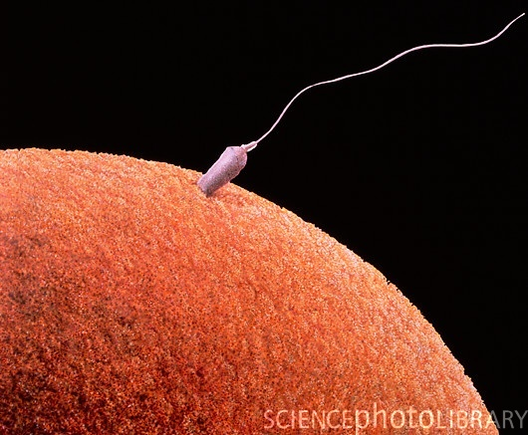
Sexual Reproduction
However, sex cells, only have 23 chromosomes, exactly half the usual number
This is because when male and female sex cells join together they create a cell with 46 chromosomes (23 chromosomes from each)
Each parent contributes one half of the total number of chromosomes
Male sex cells are called sperm
Female sex cells are called ova (sing. ovum)

Slide 7
Sexual Reproduction
But why sexual reproduction?
Sexual reproduction where two parents are contributing genetic information allows for greater variety in the genetic pool
This explains why different characteristics within the same species are passed on.

Slide 8
Meiosis
Meiosis is the process of creating sex cells
Different process than Mitosis
In meiosis, the daughter cells that are formed are sex cells
Each daughter cell only has half the usual number of chromosomes
They are haploid

Slide 9
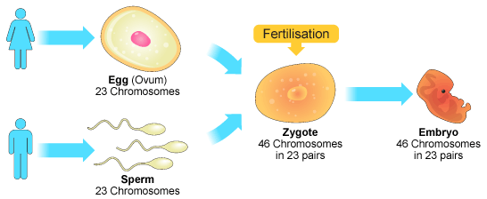
Key Concept: Meiosis and sexual reproduction allow for the combination of ______ material from two _______ cells.
genetic
different
1) Before sexual reproduction can occur, each parent must reduce his or her number of chromosomes in half by a process called ______.
meiosis
Example: Humans have 46 chromosomes, so the egg and sperm cells each have ___ chromosomes.
23

Slide 10
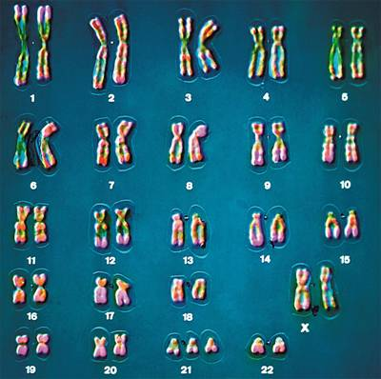
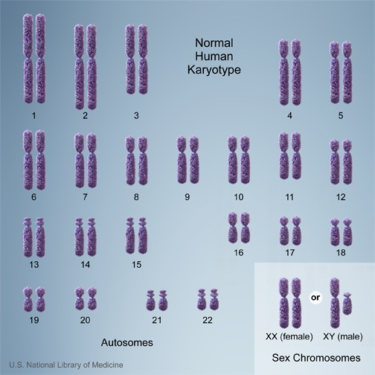
Genetic
______ information is contained on structures called chromosomes.
How many total chromosomes are there?
46
How many pairs of chromosomes are there?
23

Slide 11
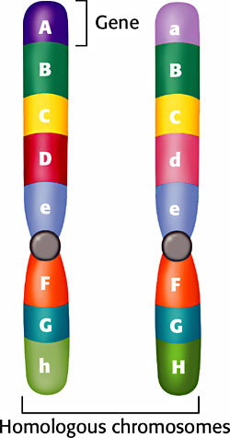
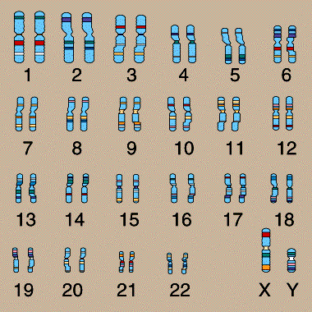
Homologous Chromosomes
Paired chromosomes that carry the same sets of genes are called _________ chromosomes.
homologous
Homologous chromosomes carry the same genes, but may have different ______.
alleles
Humans have ___ pairs of homologous chromosomes.
23

Slide 12
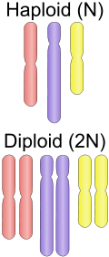
Body cells contain homologous pairs of chromosomes are called ______.
diploid
Sex cells contain one chromosome of each pair and are called ______.
haploid
These are not homologous chromosomes.
Human body cells have ___ chromosomes.
46
Human sex cells have ___ chromosomes.
23

Slide 13
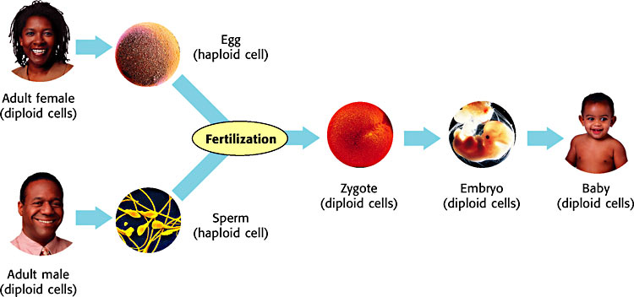
Diploid or Haploid?

Slide 14
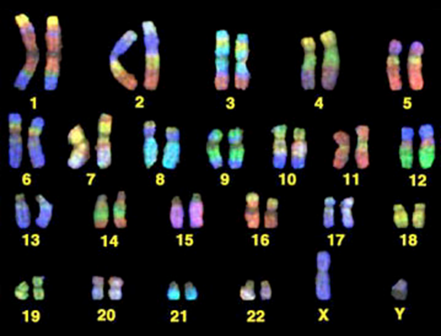

Slide 15
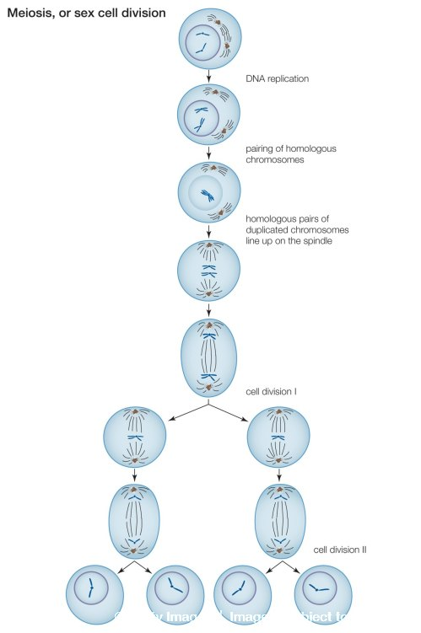

Slide 16
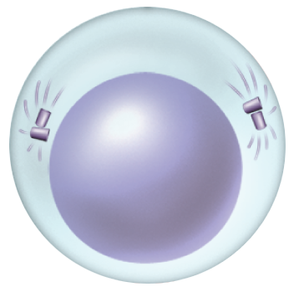
Sexual Reproduction and Genetics
Meiosis
Meiosis I
Interphase
Chromosomes replicate.
Chromatin condenses.
Interphase

Slide 17
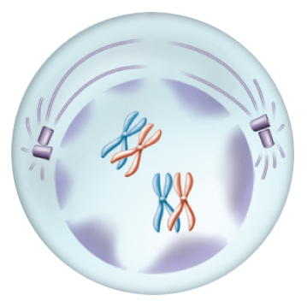
Sexual Reproduction and Genetics
Meiosis
Meiosis I
Prophase I
Pairing of homologous chromosomes occurs.
Each chromosome consists of two chromatids.
Prophase I
The nuclear membrane breaks down.
Spindles form.

Slide 18
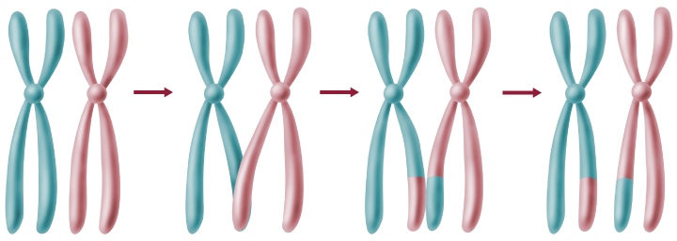
Sexual Reproduction and Genetics
Meiosis
Meiosis I
Prophase I
Crossing over produces exchange of genetic information.
Crossing over—chromosomal segments are exchanged between a pair of homologous chromosomes.

Slide 19
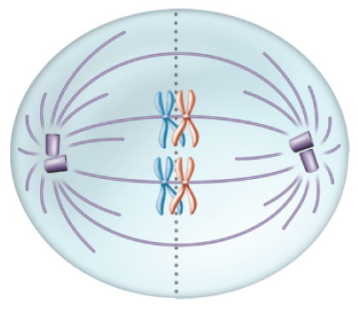
Sexual Reproduction and Genetics
Meiosis
Meiosis I
Metaphase I
Chromosome centromeres attach to spindle fibers.
Metaphase I
Homologous chromosomes line up at the equator.

Slide 20
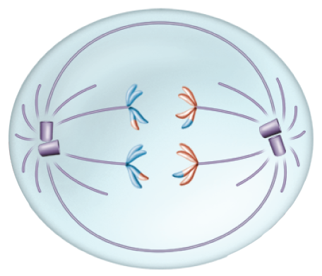
Sexual Reproduction and Genetics
Meiosis
Meiosis I
Anaphase I
Homologous chromosomes separate and move
Anaphase I
to opposite poles of the cell.

Slide 21
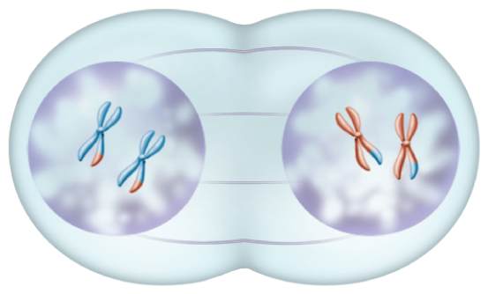
Sexual Reproduction and Genetics
Meiosis
Meiosis I
Telophase I
The spindles break down.
Telophase I
Chromosomes uncoil and form two nuclei.
The cell divides.

Slide 22
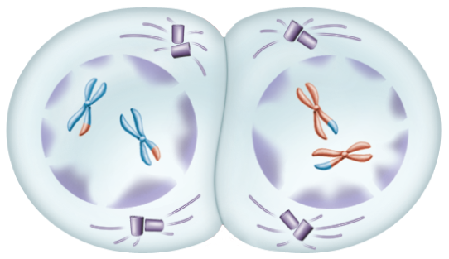
Sexual Reproduction and Genetics
Meiosis
Meiosis II
Prophase II
A second set of phases begins
Prophase II
as the spindle apparatus forms and the chromosomes condense.

Slide 23
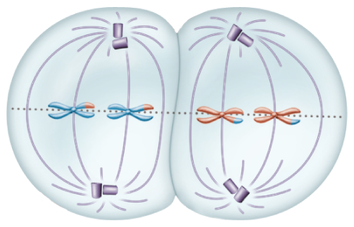
Sexual Reproduction and Genetics
Meiosis
Meiosis II
Metaphase II
A haploid number of chromosomes
Metaphase II
line up at the equator.

Slide 24
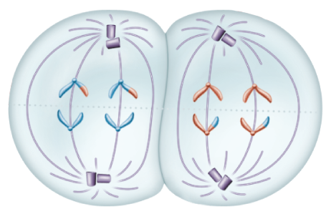
Sexual Reproduction and Genetics
Meiosis
Meiosis II
Anaphase II
The sister chromatids are
Anaphase II
pulled apart at the centromere by spindle
fibers and move toward the opposite poles
of the cell.

Slide 25
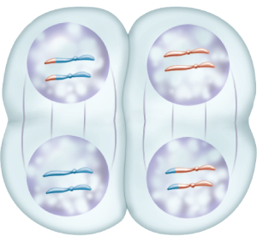
Sexual Reproduction and Genetics
Meiosis
Meiosis II
Telophase II
The chromosomes reach the poles, and
Telophase II
the nuclear membrane and nuclei reform.

Slide 26
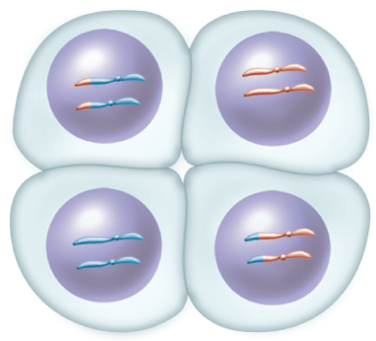
Sexual Reproduction and Genetics
Meiosis
Meiosis II
Cytokinesis results in four haploid cells, each with n number of chromosomes.
Cytokinesis

Slide 27
Sexual Reproduction and Genetics
Meiosis
The Importance of Meiosis
Meiosis consists of two sets of divisions
Produces four haploid daughter cells that are not identical
Results in genetic variation

Slide 28
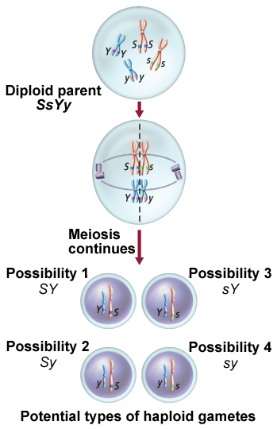
Sexual Reproduction and Genetics
Meiosis
Meiosis Provides Variation
Depending on how the chromosomes line up at the equator, four gametes with four different combinations of chromosomes can result.
Genetic variation also is produced during crossing over and during fertilization, when gametes randomly combine.

Slide 29
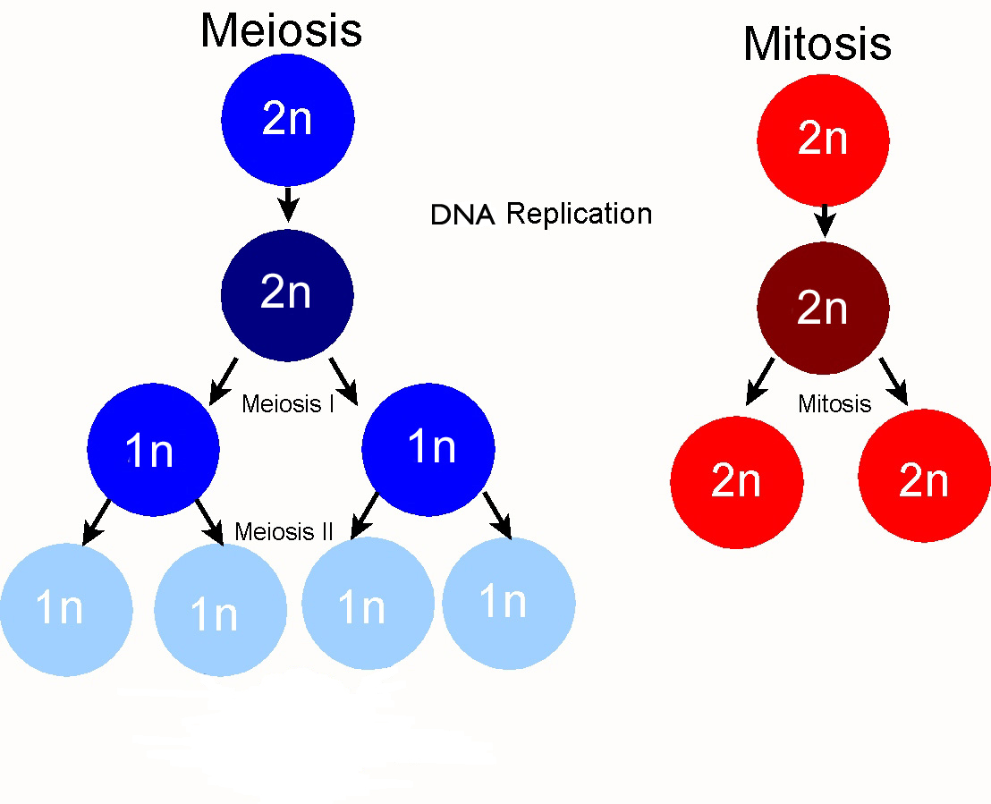
Mitosis vs Meiosis

